Slide 1
COMP257 Data Science
By Blake and Samuel

Slide 2
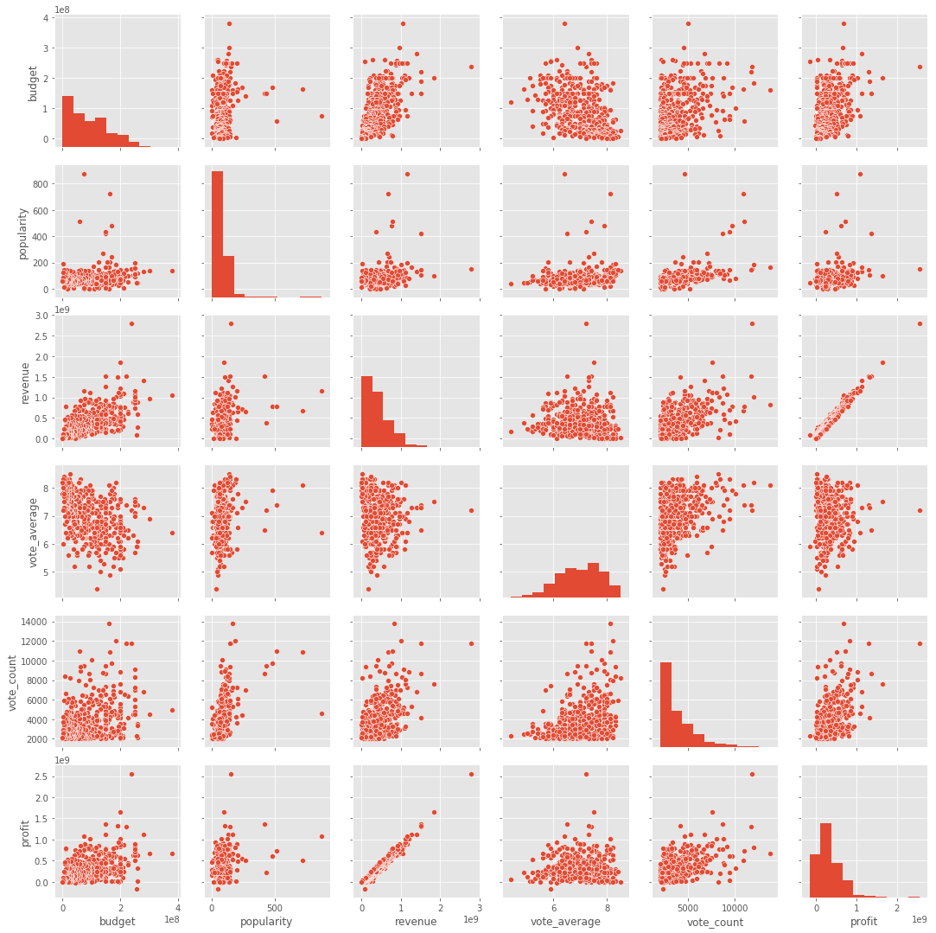
Stargazing in Hollywood.
Can the stars of a film be a predictor to its success?

Slide 3
http://datascience.samuelhornsey.com

Slide 4
Conclusion

